Slide 1
COMPUTER ORGANISATION
DATA REPRESENTATION IN COMPUTER ORGANISATION

Slide 2
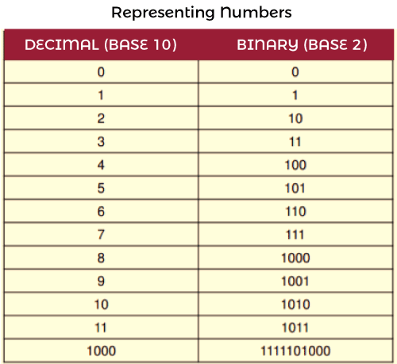
What Is Data?
Data-Data can be anything like a number, a name, notes in a musical composition, or the color in a photograph. Data representation can be referred to as the form in which we stored the data, processed it and transmitted it. In order to store the data in digital format, we can use any device like computers, smartphones, and iPads. Electronic circuitry is used to handle the stored data.
.

Slide 3
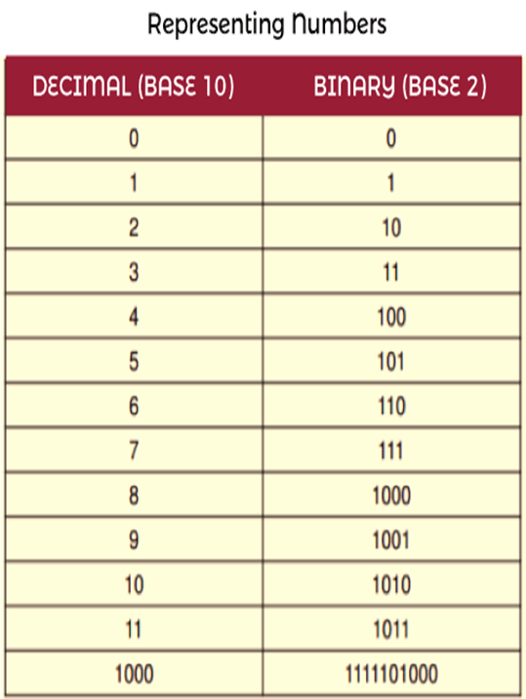
Digitization
?
What Is
Digitization-Digitization is a type of process in which we convert information like photos, music, number, text into digital data. Electronic devices are used to manipulate these types of data. The digital revolution has evolved with the help of 4 phases, starting with the big, expensive standalone computers and progressing to today's digital world. All around the world, small and inexpensive devices are spreading everywhere.

Slide 4
What Are Binary Digits?
Binary Digits-The binary digits or bits are used to show the digital data, which is represented by 0 and 1. The binary digits can be called the smallest unit of information in a computer. The main use of binary digit is that it can store the information or data in the form of 0s and 1s. It contains a value that can be on/off or true/false. On or true will be represented by the 1, and off or false will be represented by the 0. The digital file is a simple file, which is used to collect data contained by the storage medium like the flash drive, CD, hard disk, or DVD.

Slide 5
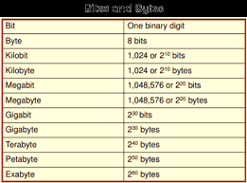
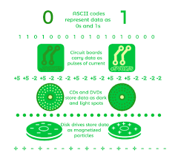
Data Representation In Computer Organisation

Slide 6
Representing Numbers
Numeric data is used to contain numbers, which helps us to perform arithmetic operations. The digital devices use a binary number system so that they can represent numeric data. The binary number system can only be represented by two digits 0 and 1. There can't be any other digits like 2 in the system. If we want to represent number 2 in binary, then we will write it as 10.

Slide 7
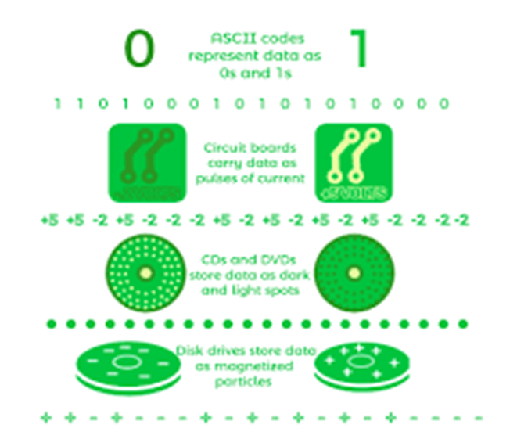
Representing Text
Character Data-Character data can be formed with the help of symbols, letters, and numerals, but they cant be used in calculations. Using the character data, we can form our address, hair colour, name, etc. Character data normally takes the data in the form of text. With the help of the text, we can describe many things like our father name, mother name, etc.

Slide 8
Representing Text
Extended ASCII-Extended ASCII can be described as a superset of ASCII. The ASCII set uses 7 bits to represent every character, but the Extended ASCII uses 8 bits to represent each character. The extended ASCII contains 7 bits of ASCII characters and 1 bit for additional characters. Using the 7 bits, the ASCII code provides code for 128 unique symbols or characters, but Extended ASCII provides code for 256 unique symbols or characters. For the uppercase letter A, the Extended ASCII code is represented as 01000001.

Slide 9
Representing Text
Digital Devices-Several types of codes are employed by the digital devices to represent character data, including Unicode, ASCII, and other types of variants. The full form of ASCII is American Standard Code for Information Interchange. It is a type of character encoding standard, which is used for electronic communication. With the help of telecommunication equipment, computers and many other devices, ASCII code can represent the text. The ASCII code needs 7 bits for each character, where the unique character is represented by every single bit. For the uppercase letter A, the ASCII code is represented as 1000001.

Slide 10
Representing Text
Unicode-Unicode is also known as the universal character encoding standard. Unicode provides a way through which an individual character can be represented in the form of web pages, text files, and other documents. Using ASCII, we can only represent the basic English characters, but with the help of Unicode, we can represent characters from all languages around the World.

Slide 11
Representing Text
ASCII Code-ASCII code can be used for numerals like phone numbers and social security numbers. ASCII text contains plain and unformatted text. This type of file will be saved in a text file format, which contains a name ending with .txt. These files are labelled differently on different systems, like Windows operating system labelled these files as "Text document" and Apple devices labelled these files as "Plain Text". There will have no formatting in the ASCII text files. If we want to make the documents with styles and formats, then we have to embed formatting codes in the text.

Slide 12


